Slide 1
Proof-of-Stake

Slide 2
Current algorithm (Proof-of-Work)
Requires lots of (specialized) hardware (specifically ASIC) to be able to mine blocks into the network (currently used by Bitcoin and Ethereum)
Wastage of large amounts of electricity that were used for mining only (enough to power Ireland [1,6])
Centralization risks (due to use of mining pools), 51% attack more probable

Slide 3
Proof-of-Stake
Removes the need for specialized hardware and exponential use of electricity
Decentralizes power back to the users, away from traditional mining pools
Requires users to have cryptocurrency

Slide 4
Ethereum Dev Roadmap
Homestead 14 Mar 2016 (Pi Day)
Olympic Testnet
May 2015
Serenity TBA
PoW
PoW
PoS
PoW
Hybrid PoW + PoS
Frontier 30 July 2015
Metropolis TBA

Slide 5

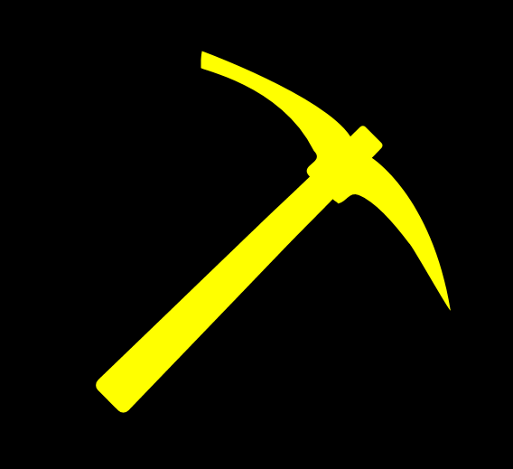
PoW Proof-of-Concept
Metropolis – Hybrid PoW + PoS
Serenity – PoS

Slide 6




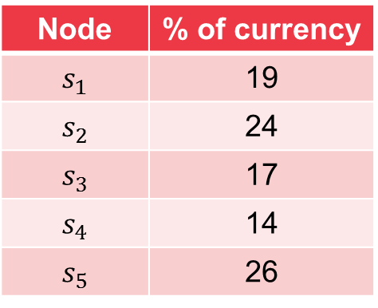

PoS Proof-of-Concept
Metropolis – Hybrid PoW + PoS
Serenity – PoS
19% by server 1
19% by server 1
19% by server 1
19% by server 1
24% by server 2
24% by server 2
24% by server 2
24% by server 2
17% by server 3
17% by server 3
17% by server 3
17% by server 3
14% by server 4
14% by server 4
14% by server 4
14% by server 4
26% by server 5
26% by server 5
26% by server 5
26% by server 5
Node | % of currency
$$s_{1}$$ | 19
$$s_{2}$$ | 24
$$s_{3}$$ | 17
$$s_{4}$$ | 14
$$s_{5}$$ | 26
$$s_{1}$$
$$s_{2}$$
$$s_{3}$$
$$s_{4}$$
$$s_{5}$$
Distributed nodes

Slide 7




PoS Proof-of-Concept (Nothing-at-Stake)
Metropolis – Hybrid PoW + PoS
Serenity – PoS
$$ω_{1}=0.9$$
Rewarded with $0.9$ if block was created on this fork
Rewarded with $0.1$ if block was created on this fork
$$ω_{2}=0.1$$
There will be users who create blocks on both forks, equivalent to double-voting (i.e. there is no reason to select one fork over the other and you’ll get both rewards)
Notes:
Assign weights to the blocks

Slide 8
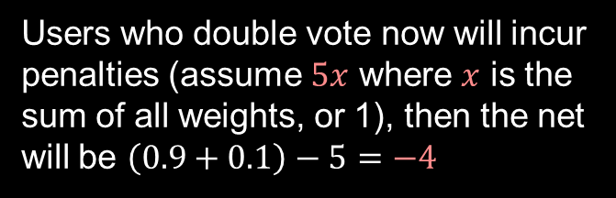
PoS Proof-of-Concept (Something-at-Stake)
Metropolis – Hybrid PoW + PoS
Serenity – PoS
$$ω_{1}=0.9$$
Rewarded with $0.9$ if block was created on this fork
Rewarded with $0.1$ if block was created on this fork
$$ω_{2}=0.1$$
Users who double vote now will incur penalties (assume $5x$ where $x$ is the sum of all weights, or 1), then the net will be $\left(0.9+0.1\right)−5=−4$

Slide 9
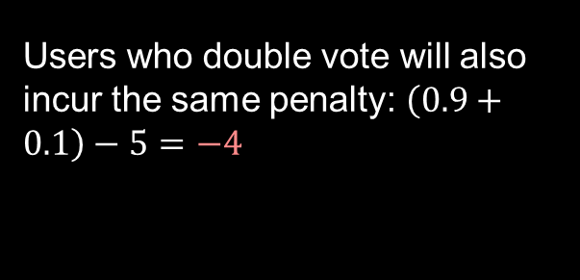
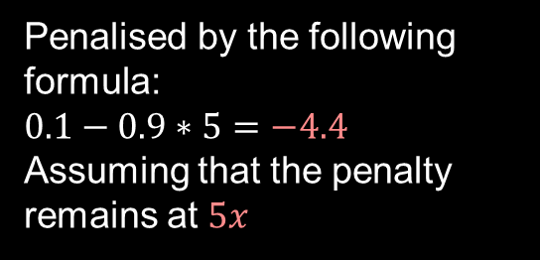
PoS Proof-of-Concept (Something-at-Stake: Slasher)
Metropolis – Hybrid PoW + PoS
Serenity – PoS
$$ω_{1}=0.9$$
Rewarded with $0.9$ if block was created on this fork
Penalised by the following formula: $$0.1−0.9∗5=−4.4$$
Assuming that the penalty remains at $5x$
$$ω_{2}=0.1$$
GHOST is explicitly used as it favours the heavier fork
Users who double vote will also incur the same penalty: $\left(0.9+0.1\right)−5=−4$

Slide 10
PoS Proof-of-Concept
Metropolis – Hybrid PoW + PoS
Serenity – PoS
No mining involved
No new coins being generated
Only transaction fees will be paid to validators
Requires a security deposit
Minimum currently set at 32 ether* [2]
Maximum currently set at 131072 ether* [2]
Rewards honest validators and penalizes those that vote on the wrong chain or vote on both chains
Ultimately all forks will converge to a single chain only
* Subject to changes since PoS not finalised

Slide 11
PoS Proof-of-Concept
Metropolis – Hybrid PoW + PoS
Serenity – PoS
Validators’ deposits are at stake, hence there is an incentive to vote on the correct chain. (Betting on the block that will be included in the chain)
Suppose that there are no security deposits, then there is no incentive to vote on the correct chain as a large number of users can sabotage the blockchain by creating another fork and making it heavier.
Minimum amount of time before validators’ can make withdrawals to their security deposits: 4 months* [2]
* Subject to changes since PoS not finalised

Slide 12

PoS Security
Since PoS requires users to have the cryptocurrency, attackers would need to buy 51% of the entire cryptocurrency network to perform a 51% attack
Consider that the current block number is approximately 4 million, so the estimated amount of ether in the system is 20 million (4 mil blocks $∗$ 5 ether/block) and the current exchange rate is USD 340/ether. To perform a 51% attack, the attacker must obtain 51% of all ether, which is equivalent to $\left(4∗{10}^{6}∗5∗51\%\right)∗340=3.468∗{10}^{9}$ USD of ether.
The cost to perform a 51% is not feasible and is significantly more expensive than a 51% on a PoW blockchain.

Slide 13
PoS Validator Selection
Metropolis – Hybrid PoW + PoS
Serenity – PoS
An estimated 9600* validators will be selected per 12 hour cycle (selection criterion unknown) [3] ^Using the current exchange rate of USD 340/ether, we can expect 104.448 million USD worth of ether being used as security deposits at any time
* Subject to changes since PoS not finalised
Notes:
Since minimum of 32 ether needed to become validator

Slide 14






PoS Proof-of-Concept (Something-at-Stake: Slasher)
Metropolis – Hybrid PoW + PoS
Serenity – PoS
Node randomly selected, probability based on the amount that was used as security deposit
Node randomly selected until it reaches a node that is online
Validators
$$s_{1}$$
$$s_{2}$$
$$s_{3}$$
$$s_{4}$$
$$s_{5}$$
$$s_{9600}$$
Offline
Notes:
Assume the case where few nodes go offline, due to network issues or the nodes were switched off

Slide 15
PoS Proof-of-Concept (Something-at-Stake: Slasher + Finalization)
Metropolis – Hybrid PoW + PoS
Serenity – PoS
F
B
A
We combine all previous theories and assume such a complex fork created

Slide 16




PoS Proof-of-Concept (Something-at-Stake: Slasher + Finalization)
Metropolis – Hybrid PoW + PoS
Serenity – PoS
F
2
1
3
W: Amount gain if added to chain
L: Amount loss if not added to chain
1
1
B
1
W: $x_{4}$
L: $y_{4}$
W: $x_{1}$
L: $y_{1}$
W: $x_{3}$
L: $y_{3}$
1
1
A
3
7
5
W: $x_{2}$
L: $y_{2}$
4
1
2
5
2
Each block will have a validator’s guarantee (or a finality bet), either they gain if validated or lose if not
1
1

Slide 17
PoS Proof-of-Concept (Something-at-Stake: Slasher + Finalization)
Metropolis – Hybrid PoW + PoS
Serenity – PoS
F
2
1
3
Finalization candidate
1
1
B
1
Latest finalized block
1
1
A
3
7
5
4
1
2
5
2
1
1
Need to finalize the chain and remove forks
1

Slide 18
PoS Proof-of-Concept (Something-at-Stake: Slasher + Finalization)
Metropolis – Hybrid PoW + PoS
Serenity – PoS
F
2
1
3
L: 6
B: 1
Sum: 7
1
1
B
1
L: 7
B: 10
Sum: 17
1
1
A
3
7
5
4
1
2
5
2
Length and finality bet at chain ends are calculated (applies to blocks behind finalization candidate)
1
L: 8
B: 10
Sum: 18
2
1

Slide 19
PoS Proof-of-Concept (Something-at-Stake: Slasher + Finalization)
Metropolis – Hybrid PoW + PoS
Serenity – PoS
3
Validators of all stale blocks are penalized and are known as “dunkles” in Casper

Slide 20
Notes on Ethereum PoS
Metropolis – Hybrid PoW + PoS
Serenity – PoS
Expected negative net issuance (with removal of ether from the system through penalization)
Faster block creation (estimated to be 4 seconds, conservative number to prevent overhead) [2]
If forks are created in a manner as presented in the previous slide, there is a high probability that loss of ether > gain
* Subject to changes since PoS not finalised

Slide 21
Notes on Ethereum PoS
Metropolis – Hybrid PoW + PoS
Serenity – PoS
Light clients will be able to sync extremely fast as they would need to only verify the validator set against the header

Slide 22
References
https://karlodwyer.github.io/publications/pdf/bitcoin_KJOD_2014.pdf
https://cdn.hackaday.io/files/10879465447136/Mauve%20Paper%20Vitalik.pdf
https://www.reddit.com/r/ethereum/comments/535fiw/mauve_paper_20_third_draft/
https://blog.ethereum.org/2015/12/28/understanding-serenity-part-2-casper/
https://blog.ethereum.org/2014/11/25/proof-stake-learned-love-weak-subjectivity/
https://ethereum.stackexchange.com/questions/9/why-does-ethereum-plan-to-move-to-proof-of-stake
https://github.com/ethereum/wiki/wiki/Proof-of-Stake-FAQ

